Slide 1

Note: The data and information in this document is reflective of a hypothetical situation and client. This document is to be used for KPMG Virtual Internship purposes only.
Sprocket Central Pty Ltd
Data analytics approach
Data Analyst - Vania

Slide 2
Note: The data and information in this document is reflective of a hypothetical situation and client. This document is to be used for KPMG Virtual Internship purposes only.
Agenda
Introduction
Data Exploration
Model Development
Interpretation

Slide 3
Note: The data and information in this document is reflective of a hypothetical situation and client. This document is to be used for KPMG Virtual Internship purposes only.
Introduction
Background
Data
Sprocket Central Pty Ltd is a long-standing KPMG client whom specialises in high-quality bikes and accessible cycling accessories to riders. Their marketing team is looking to boost business by analysing their existing customer dataset to determine customer trends and behaviour.
Using the existing 3 datasets; Customer demographic, Customer address, and Transactions
Goal
Giving recommend which of these 1000 new customers should be targeted to drive the most value for the organisation.

Slide 4
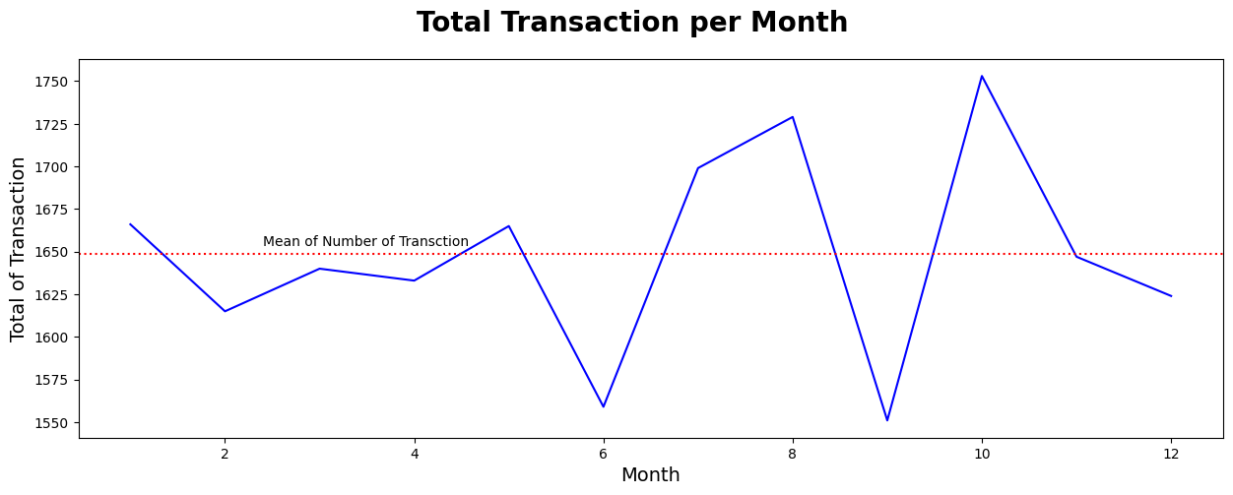
Note: The data and information in this document is reflective of a hypothetical situation and client. This document is to be used for KPMG Virtual Internship purposes only.
Data Exploration
Total Transaction per Month
We can see that the graph goes up and down, especially between June – October. The lowest transaction is in September while the peak is in October. The changes in transactions on first semester were not too significant. However, in the following semester the situation was reversed. The average number of transactions is 3650.

Slide 5
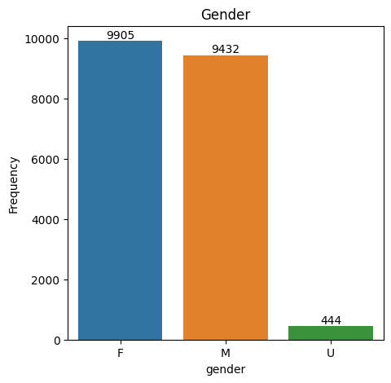
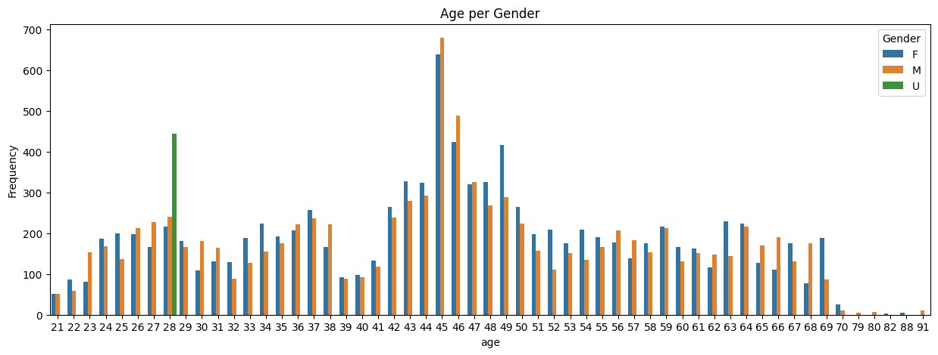
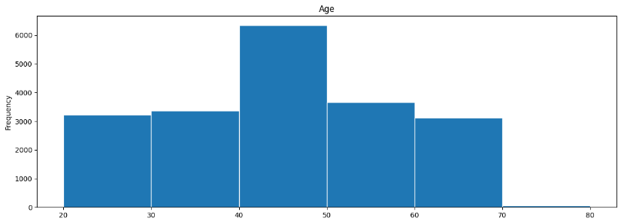
Note: The data and information in this document is reflective of a hypothetical situation and client. This document is to be used for KPMG Virtual Internship purposes only.
Data Exploration
Age and Gender
Based on the graph, most of the customer is around 40-50 years old and the most gender is Female. The most customer’s age precisely is 45 years old. There are some unidentified gender on customer who 28 years old with 444 people.

Slide 6
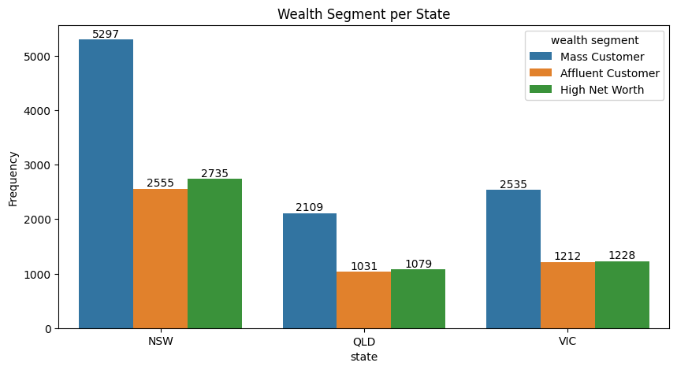
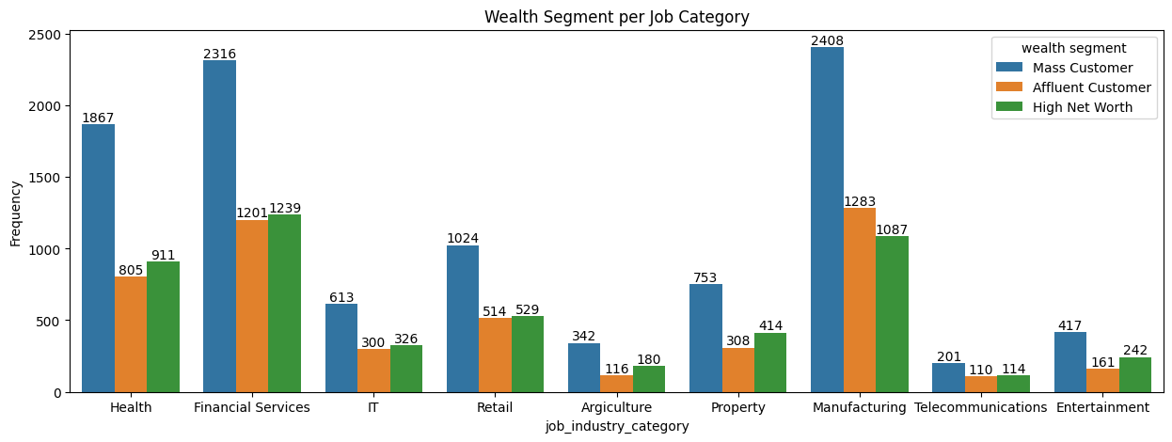
Note: The data and information in this document is reflective of a hypothetical situation and client. This document is to be used for KPMG Virtual Internship purposes only.
Data Exploration
Wealth Segment
We exploring wealth segment and group them by State and Job Category. As we can see, most of them are from New South Wales and have a job category in Financial Services and Manufacturing. Most of them are a Mass Customer.

Slide 7
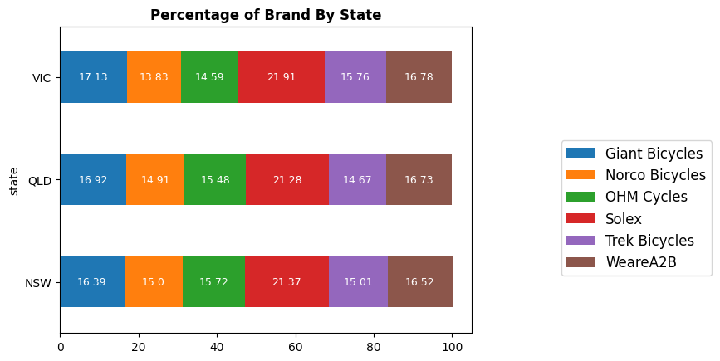
Note: The data and information in this document is reflective of a hypothetical situation and client. This document is to be used for KPMG Virtual Internship purposes only.
Data Exploration
Brand Bikes
We grouping the brand by state and calculate the percentage. Based on the graph, the most sold brand is Solex on those three states. Following by Giant Bicycles and WeareA2B.

Slide 8
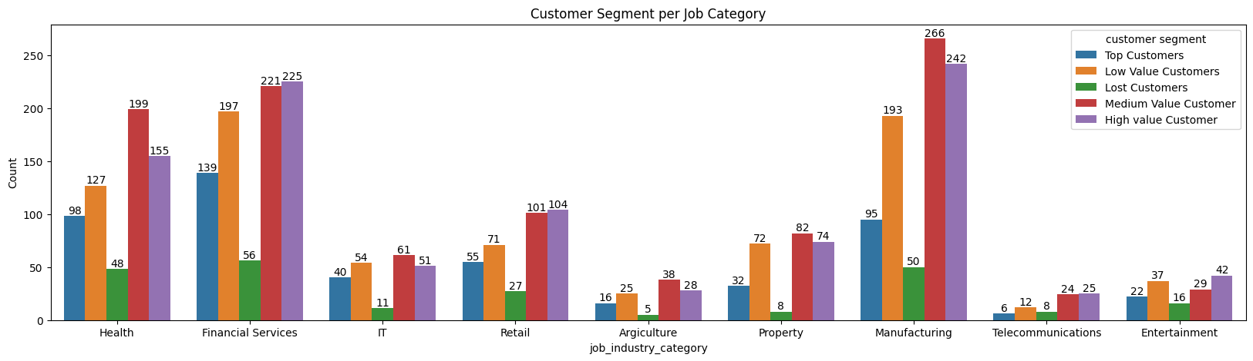
Note: The data and information in this document is reflective of a hypothetical situation and client. This document is to be used for KPMG Virtual Internship purposes only.
Model Development
RFM
Then, we did the RFM to find the potential customers. The score falls between 0-5. Top Customers is customer with >4 score, High value with >3 score, Medium value with >2 score, Low value with >1 score, and Lost customers with less than 1 score.
From the graph, we can see that the most Top Customers and High value customers are in Financial Services and Manufacturing.

Slide 9
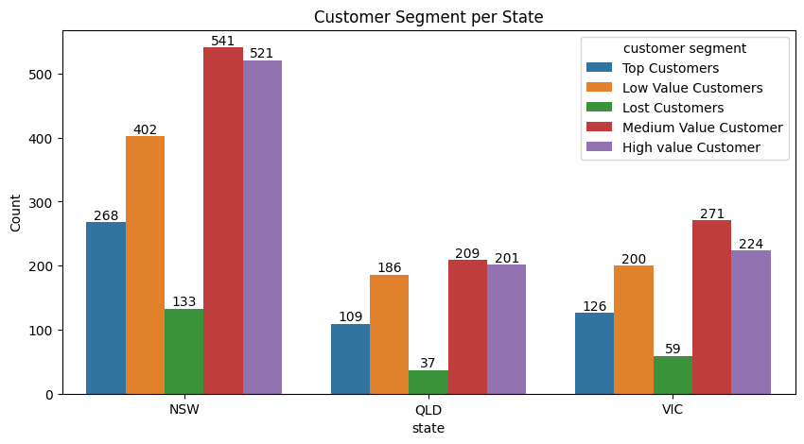
Note: The data and information in this document is reflective of a hypothetical situation and client. This document is to be used for KPMG Virtual Internship purposes only.
Model Development
RFM
If we see it from State, the most Top and High value customers are in New South Wales. Although majority of them are Medium value customers with 541 people, a slight difference from the High value one.

Slide 10
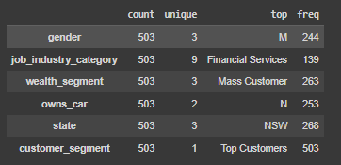
Note: The data and information in this document is reflective of a hypothetical situation and client. This document is to be used for KPMG Virtual Internship purposes only.
Interpretation
What we can conclude
The Top Customers are customers with the highest RFM score, so they’ll be the potential customers. Picture beside is the detail from the Top Customers profile. Most of them are Male who work at Financial Services, in the category as mass customer and stay at New South Wales. And most of them don’t own car, maybe that’s why they buy or use bicycle.
Beside it, most of the customers’ age falls between 40-50 years old. Perhaps they use bikes for transportation or exercise.
The company can boost the selling for brand Solex bikes and expect more from the Mass Customer.

Slide 11
Note: The data and information in this document is reflective of a hypothetical situation and client. This document is to be used for KPMG Virtual Internship purposes only.
Thanks

